Slide 1
Circuits Lecture 8: Thevenin and Norton Theorem (1)
李宏毅 Hung-yi Lee

Slide 2
Textbook
Chapter 2.5

Slide 3
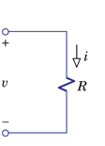
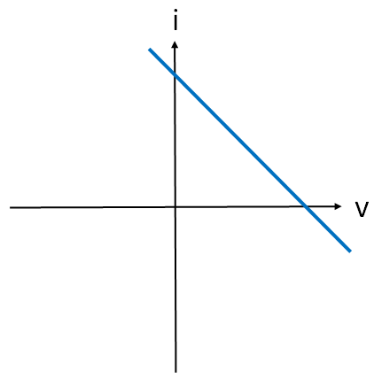
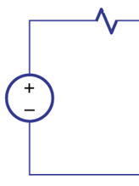
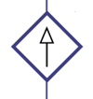
Network
A two-terminal network is a function represented by i-v characteristics
Given a network, computing its i-v characteristics, and then label it with simpler equivalent network
i
v

Slide 4
Computing i-v characteristics
i
i
v
v
Add a voltage source v
Add a current source i
v is a unknown variable
i is a unknown variable
Find i
Find v
Represented by v
Represented by i
Obtain the relation of i and v
Obtain the relation of i and v

Slide 5
Computing i-v characteristics
i
Independent Sources
x₁, x₂, x₃ ……
Voltage source v
v
i is the weighted sum of the voltage (or current) of the sources.
The relation of i and v is linear!
constant

Slide 6
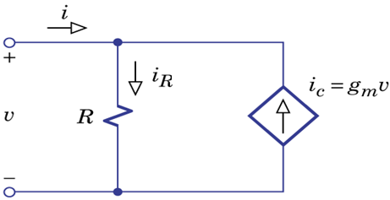
Computing i-v characteristics
The v-i characteristics is linear!
Case 1: current source
i
i=mv
Case 2: voltage source
Case 3: resistor
Resistor
v
with resistance 1/m Ω
m>0, normal resistor
m<0, ?
Negative resistor

Slide 7
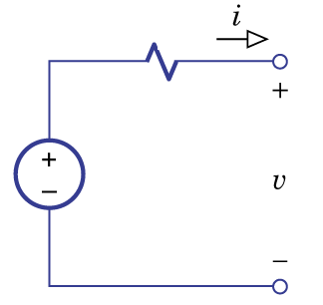
Computing i-v characteristics
Case 4: resistor +voltage source
i
v
Notes:
How about other direction?

Slide 8
Computing i-v characteristics
The v-i characteristics is linear!
Case 1: current source
i
Case 2: voltage source
Case 3: resistor
Case 4: resistor +voltage source
v

Slide 9
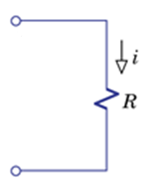
Thevenin Theorem
Two
Terminal
Network
Two terminal network consists entirely of independent source, resistor and controlled sources.
If controlled sources are present, then the control variables is within the same network.
Find v_{oc} and R_{t} directly without drawing i-v characteristics?
Notes:
Two versions of Thevenin :
weak vs strong
Why for the controlled sources?

Slide 10
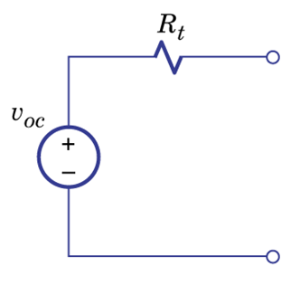
Thevenin Theorem - v_{oc}
Two
Terminal
Network
Keep two terminals open

Slide 11
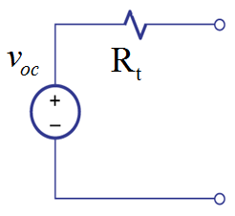
Thevenin Theorem - R_{t}
Textbook P72 - 73
Suppress the independent sources:
Voltage Source
Short
Current Source
Open
Why?????
(As we have done in Superposition)

Slide 12
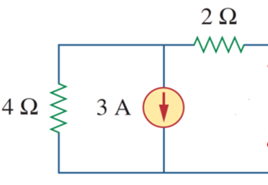
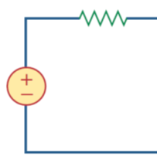
Thevenin Theorem - R_{t} (Example)
Suppress the independent sources
Refer to lecture 7

Slide 13
Thevenin Theorem - R_{t}
i
v
Superposition:
Voltage source v
Independent Sources in network: x₁, x₂, x₃ ……

Slide 14
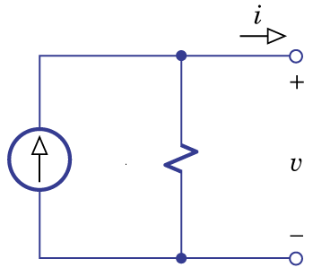
Norton Theorem
Thevenin
Theorem
Two
Terminal
Network
Norton
Theorem

Slide 15
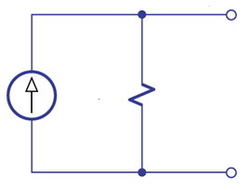
Norton Theorem - i_{sc}
Two
Terminal
Network
Let two terminals short
After we find i_{sc},
If we already know v_{oc}, R_{t}=v_{oc}/i_{sc}
If we already know R_{t}, v_{oc}=i_{sc}R_{t}

Slide 16
Thevenin Parameters
V_{oc}, R_{t} and i_{sc} are Thevenin parameters
v_{oc}: keep the two terminals open
R_{t}: suppress the independent sources
i_{sc}: let the two terminals short
Know any of two can find the last one
Notes:
Real application

Slide 17
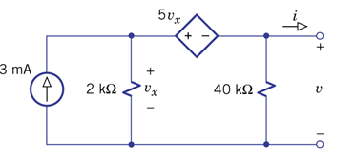
Example 2.14

Slide 18
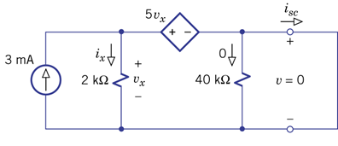
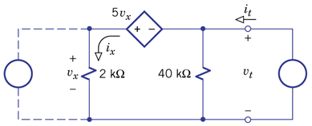
Example 2.14
Open circuit
Find v_{oc}
Short Circuit
Find i_{sc}
Set to Zero
Find R_{t}

Slide 19
Example 2.14
Short Circuit
Then “open circuit” or “source set to zero”?

Slide 20
Example 2.14
Source set to zero
Find equivalent resistance R_{t}

Slide 21
Example 2.14

Slide 22
Example 2.14
Check: Open circuit

Slide 23
Example
Find the current and voltage on R_{L}
Circuit Analysis
Three-terminal networks?
Obliterate R_{L}
Thevenin Theorem

Slide 24
Example
Find the current and voltage on R_{L}
i
$$RL$$
+
-
Find Thevenin Parameters

Slide 25
Example
Find the current and voltage on R_{L}
Open circuit
Short Circuit
Set to Zero
Find v_{oc}
Find i_{sc}
Find R_{t}

Slide 26
Example
Find the current and voltage on R_{L}
$$v_{oc}=v_{a}−v_{b}$$
$$=V_{s}\frac{R_{3}}{R_{1}+R_{3}}−V_{s}\frac{R_{4}}{R_{2}+R_{4}}$$
So easy!
Open circuit
Find v_{oc}

Slide 27
Example
Find the current and voltage on R_{L}
R₁, R₂, R₃, R₄:
$$R_{eq}=\frac{R_{1}R_{2}}{R_{1}+R_{2}}+\frac{R_{3}R_{4}}{R_{3}+R_{4}}$$
$$i_{V_{s}}=\frac{V_{s}}{R_{eq}}$$
$$i_{R_{1}}=\frac{V_{s}}{R_{eq}}\frac{R_{2}}{R_{1}+R_{2}}$$
$$i_{R_{3}}=\frac{V_{s}}{R_{eq}}\frac{R_{4}}{R_{3}+R_{4}}$$
$$i_{sc}=i_{R_{1}}−i_{R_{3}}=\frac{V_{s}}{R_{eq}}\left(\frac{R_{2}}{R_{1}+R_{2}}−\frac{R_{4}}{R_{3}+R_{4}}\right)$$
Short Circuit
Find i_{sc}
$$v_{oc}=V_{s}\frac{R_{3}}{R_{1}+R_{3}}−V_{s}\frac{R_{4}}{R_{2}+R_{4}}$$
$$R_{t}=\frac{v_{oc}}{i_{sc}}=…$$
(last page)

Slide 28
Example
Find the current and voltage on R_{L}
Simple (but hard to figure out)
$$R_{t}=\frac{R_{1}R_{3}}{R_{1}+R_{3}}+\frac{R_{2}R_{4}}{R_{2}+R_{4}}$$
Set to Zero
Find R_{t}
$$R_{t}=\frac{v_{oc}}{i_{sc}}?$$
Check by yourself
Notes:
Draw the process on the black broad

Slide 29
Example
Find the current and voltage on R_{L}
i
$$RL$$
+
-
$$v_{oc}=V_{s}\frac{R_{3}}{R_{1}+R_{3}}−V_{s}\frac{R_{4}}{R_{2}+R_{4}}$$
$$R_{t}=\frac{R_{1}R_{3}}{R_{1}+R_{3}}+\frac{R_{2}R_{4}}{R_{2}+R_{4}}$$

Slide 30
Homework
2.62, 2.64

Slide 31
Homework

Slide 32
Homework

Slide 33
Thank you!

Slide 34
Answer
2.62
Rt=5k, isc=vs/8k, voc=5vs/8
2.64
Rt=-60, isc=is, voc=-60is

Slide 35
Homework
Rt=100k,isc=-20m

Slide 36
Homework
Rt=-1k/60, voc=2

Slide 37
Acknowledgement
感謝 徐瑞陽(b02)
糾正錯誤的作業答案
感謝 林楷恩(b02)
糾正錯誤的作業答案

